Slide 1
Primary Key vs Foreign Key in MySQL

Slide 2

Course Code : CSE311
Course Title : Database Management System
Presented To :
Nusrat Khan Lecturer , Department of CSE
Daffodil International University
Presented By : TETHYS DEBUG ENTITY Section : 64_B Department of CSE
Daffodil International University

Slide 3
Team Members and Contents
Name | Student ID | Topic
Md. Hasib Hossain | 0242310005101195 | Introduciton
Mst. Sumaya Akter Dipty | 0242310005101778 | Understanding Primary Key
Tasnia Tarannum Silme | 0242310005101090 | Understanding Foreign Key
Meheruba Binte Kashem Anti | 0242310005101157 | Key Differences + Advantages & Disadvantages of Primary Key
MD Sazzadul Islam Shaon | 0242310005101028 | Advantages & Disadvantages of Foreign Key + Conclusion

Slide 4

01
Keys help in data organization and integrity.
02
Primary Key uniquely identifies each record.
Introduction to Database Keys
03
Foreign Key links records between tables.
04
Keys enforce relationships in relational databases.
05
Used in MySQL to maintain consistency.

Slide 5

Understanding Primary Key
Definition
A Primary Key is a unique identifier for each record in a database table. It ensures that no two rows have the same key value.
Purpose
Used to uniquely identify records and enforce entity integrity in relational databases like MySQL.
Example
For a ‘STUDENTINFO' table, the ‘Stu_Id' column can be a Primary Key, ensuring each user has a unique identifier.

Slide 6
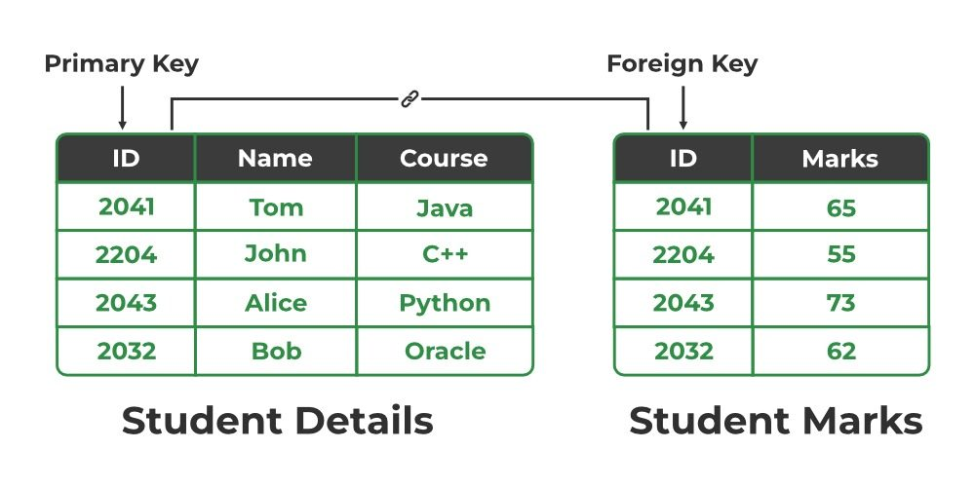
Understanding Foreign Key
Definition
A Foreign Key is a column or set of columns in a table that establishes a link to the Primary Key of another table.
Purpose
Used to maintain referential integrity between related tables and enforce relationships.
Example
A ‘Student Marks' table may have a ‘ID' column as a Foreign Key, referencing the ‘ID' in the ‘Student Details' table.

Slide 7

Primary Key vs Foreign Key - Key Differences
Uniqueness
A Primary Key uniquely identifies each record, while a Foreign Key links records between tables.
Purpose
Primary Keys ensure entity integrity, while Foreign Keys enforce referential integrity.
Constraints
A Primary Key cannot have NULL values, whereas a Foreign Key can contain NULL values if optional.

Slide 8

Advantages & Disadvantages of Primary Key
Advantages:
Ensures uniqueness of records.
Speeds up data retrieval with indexing.
Prevents duplicate records in a table.
❌ Disadvantages:
Cannot contain NULL values.
If not indexed properly, it can slow down performance.
Once set, changing it can be complex in large databases.

Slide 9

Advantages & Disadvantages of Foreign Key
Advantages:
Maintains referential integrity between tables.
Avoids data redundancy by linking related records.
Helps in cascading updates and deletes (if set properly).
❌ Disadvantages:
Can slow down inserts/updates if not indexed well.
If not handled correctly, can cause circular references.
Deleting referenced data requires careful constraints to avoid errors.

Slide 10
Final Thoughts
Primary Key ensures each record is unique within a table.
Foreign Key links tables to enforce relationships and maintain consistency.
Together, they form the backbone of relational databases.
Proper planning is essential to avoid performance issues and maintain data integrity.
Conclusion

Slide 11
?

